Slide 1
Personal IOT Assistant (PIA)
WAI YAN MIN KO KO (DMRO)
WONG JAE JUIN KADRIAN (DEEE)
Python Programming for IOT EP0401

Slide 2
Table of Contents
01
02
03
04
Interview & Persona
- CDIO Framework
Brainstorming & Idea Selection
- 2x2 Matrix
Design Process
- Concept Sketch
- Block Diagram,
- Flowchart,
- Dataflow Diagram,
- Gantt Chart

Slide 3
01
Interview & Persona

Slide 4
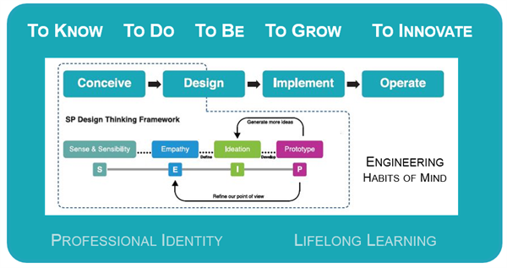

Slide 5

PERSONA
Name: Tan Wei Lian
Age: 17
Info
Has his own bedroom
Busy during the weekdays & weekends
Works Part-Time during school holidays
Mostly outside and feels tired after a long day

Slide 6

Interview
As we are recently getting busier with our lives, sometimes we don’t have time convenience . Tan Wei Liang, 17, a student who lives in a 5 room HDB flat, needs to find a way to wake up on time while at the same time feeling great as he gets ready for school and feel welcome back at home, feeling relaxed without doing even some little things such as with playing some music or switching on the lights. For now, he is either considering hiring a helper or maybe buying one of the new trendy house robots. Maybe Amazon Echo?
As so currently, there are also too limitations of sometimes hiring a helper who may not be able to do their jobs properly. He also understands that using home robots comes with a bigger cost due to the complexity and limitations.

Slide 7
02
Brainstorming & Idea Selection

Slide 8
Brainstorming
Problem: Inconvenience to control devices from one place, not being able to automate functions from devices due to these devices not having such features
Personal Assistant Device
Intelligent Personal Assistant (Google Nest, Amazon Echo)
01
02
Hiring a helper
03
04
Interactive phone app/website

Slide 9
2 x 2 MATRIX
High Impact
Personal Assistant Device
1
Intelligent Personal Assistant (Google Nest, Amazon Echo)
Interactive phone app/website
4
2
Low Feasibility
High Feasibility
Hiring a helper
3
Low Impact

Slide 10
03
Design Process

Slide 11
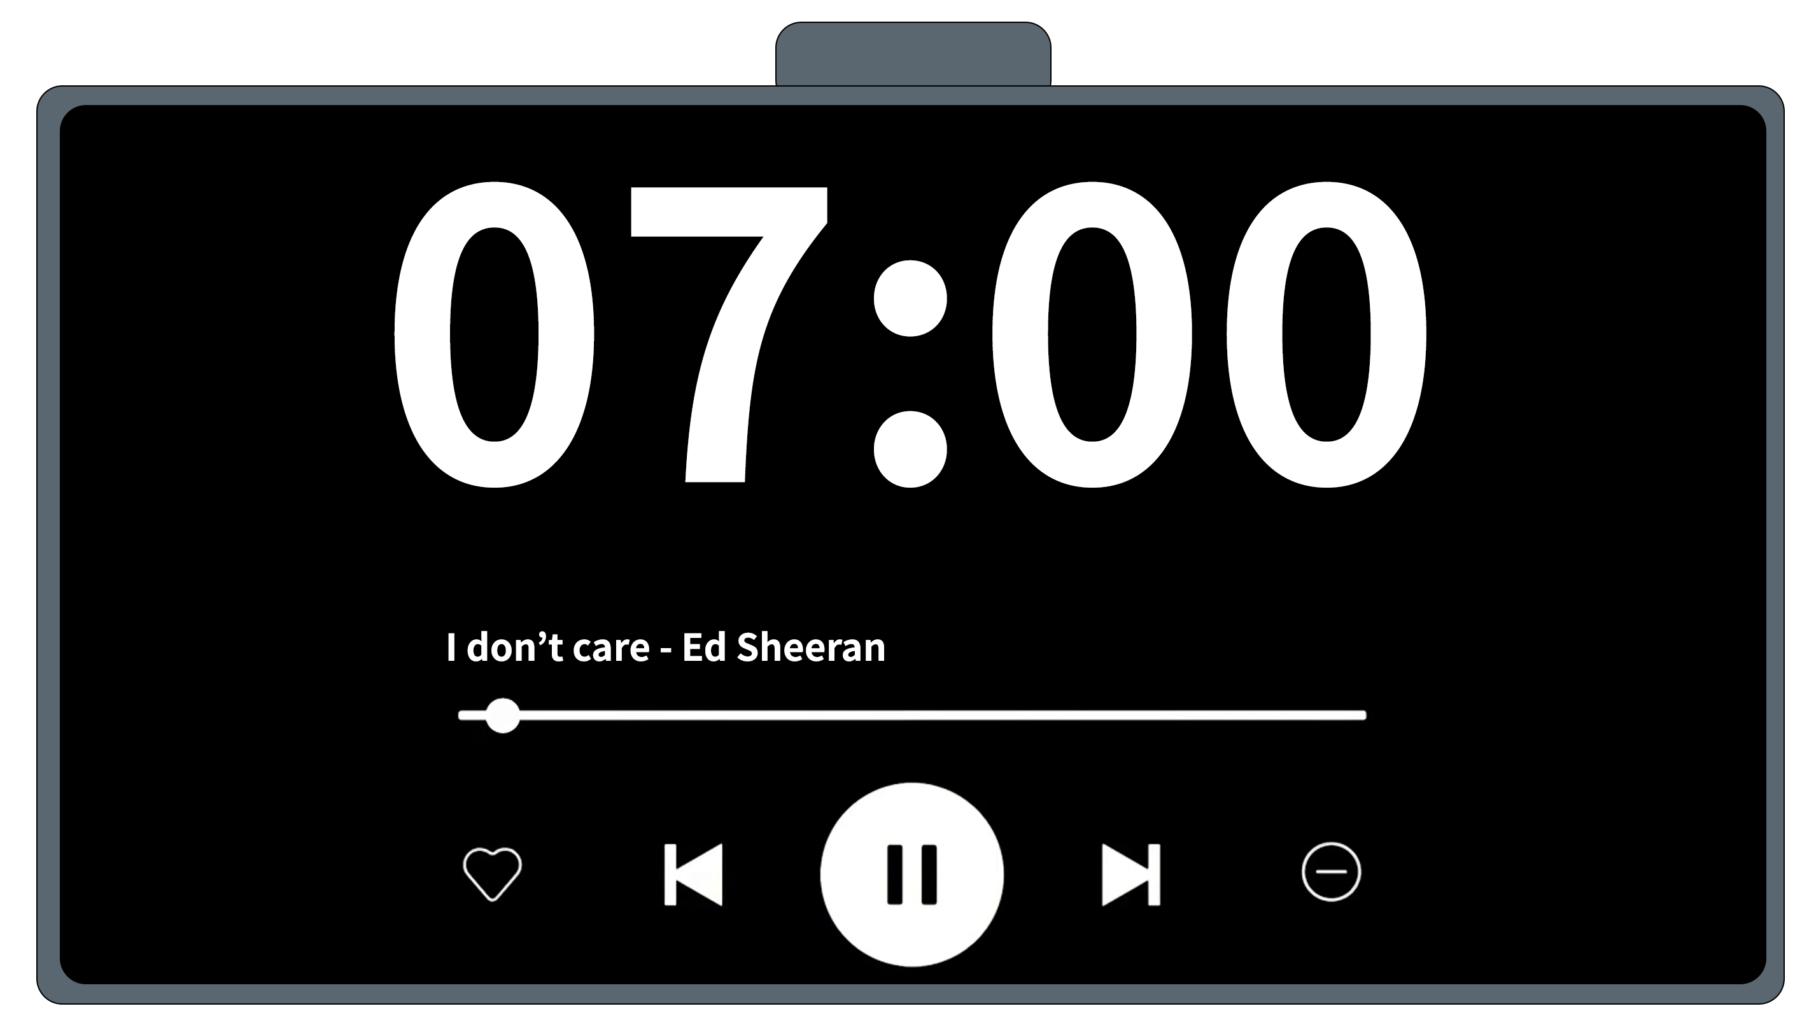
Concept Sketch
Snooze Button
Time & Music Touch Display

Slide 12
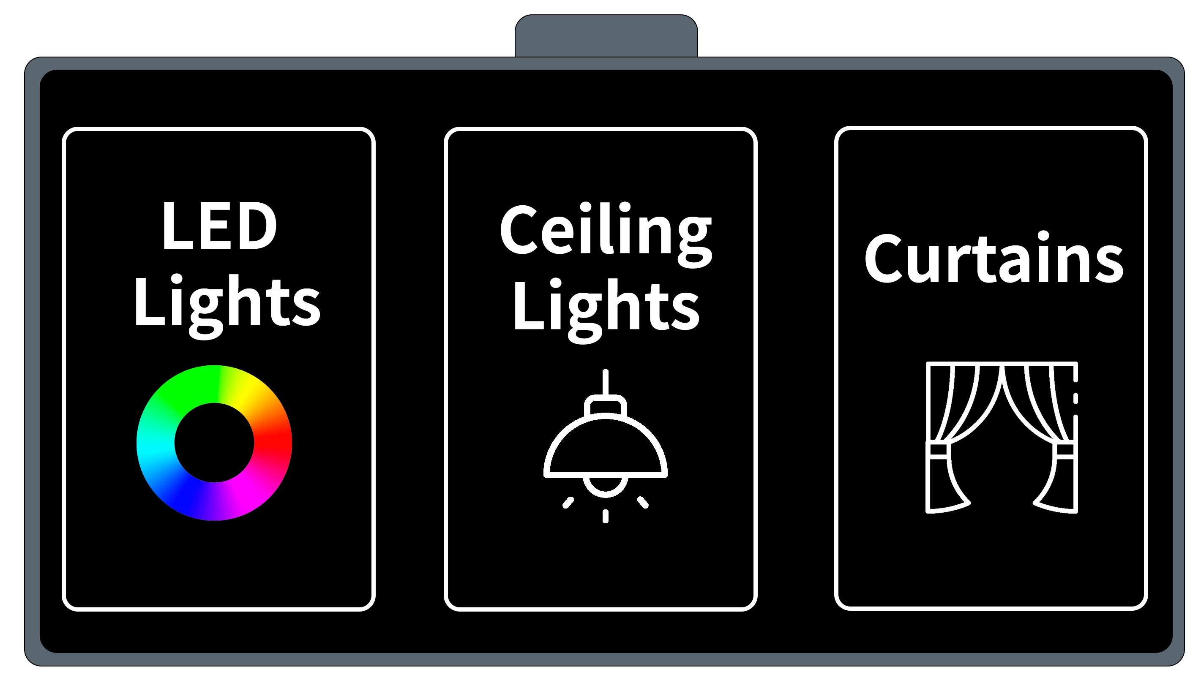
Concept Sketch
Smart Home Controls

Slide 13
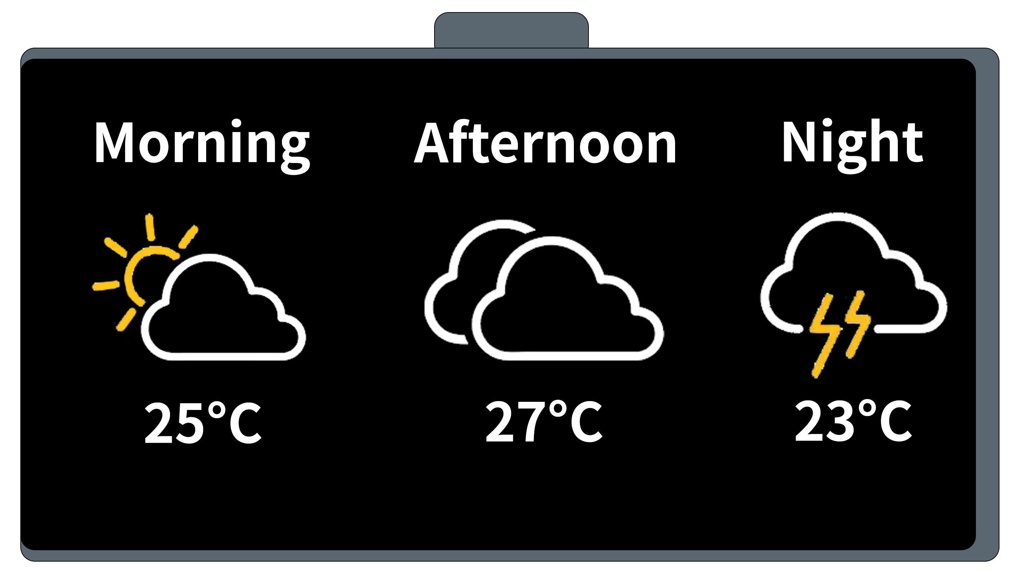
Concept Sketch
Weather Report

Slide 14
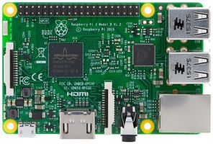
BLOCK DIAGRAM
Power Supply
LED Strip Lights (IR Sensor)
LCD
Push Buttons
Speaker (via Bluetooth)
AC (Active IR Sensor)
Servo Motor (Curtain), DC Motor (Fan)
Temp & Humidity Sensor
RFID Reader
Voice playback
Wi-Fi Module

Slide 15
FLOWCHART(MORNING)☀
START
Alarm Activated ⏰
Speakers PLAY Music of choice (Lofi) 🎶
“Good Morning”
💬
IR Sensor Switch OFF AC & Lights 💡
Speakers PLAY Alarm Ringtone🔊 or Activate Buzzer 🔔
Switch ON Ceiling Lights (LED) 💡
END
“Have a great day!” & Switch off Speaker 💬
RFID Reader detects EXIT
🚪
Untill Snooze Button is pressed ✅
Switch OFF LCD Display 🔲
Servo Motor OPEN curtains 🌞

Slide 16
FLOWCHART(Night) 🌙
“Welcome Back!”
Speakers PLAY Lofi Music 🎶
Switch OFF LED Strip Lights 💡
RFID Reader detects entry
🚪
START
END
IR Sensor Switch ON LED Strip Lights & AC 💡
When its 12AM 🕛 or Sleep Button is Pressed 💤
Switch on LCD Display 🔠
(If after 7:30PM)
Speakers stop playing Lofi Music🔈 “Goodnight!” 💬
Servo Motor CLOSE Curtains 🌝

Slide 17
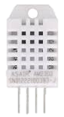
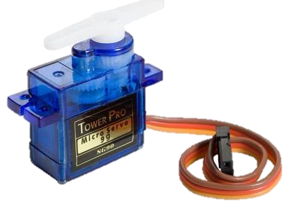
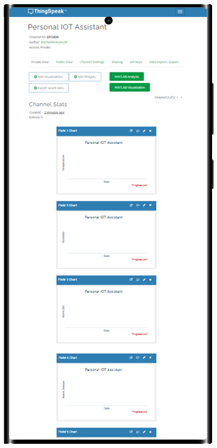
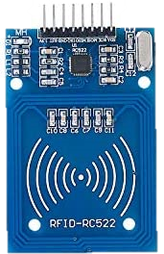

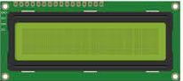
DATA FLOW DIAGRAM
Ceiling Lights Control
LED Strip Lights Control (IR Sensor)
AC Control (IR Sensor)
Temperature & Humidity (AM2032)
Entry & Exit (RFID Reader)
Display Time, Temperature & Song Playing
Time of Alarm Set & Snooze
Number of Songs Played
Status of Lights & AC

Slide 18
Gantt Chart
Week-12
Week-13
Week-14
Week-15
Week-16
Week-17
Week-18
Collecting IOT Board & External Parts
Coding our Personal IOT Assistant
Coding our Webapp & Setting Up Thingspeak
Testing, Debugging & Presentation

Slide 19
THANKS!
Do you have any questions?
WAI YAN MIN KO KO (DMRO)
WONG JAE JUIN KADRIAN (DEEE)
Please keep this slide for attribution

